Slide 1
The 2nd Round of the NIST PQC Standardization Process
Dustin Moody
Notes:
Welcome. Thank you to all the authors, teams, panelists, attendees.

Slide 2
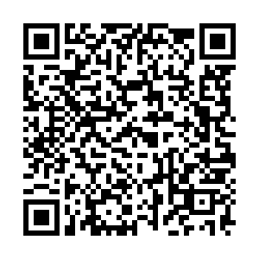
The 2nd NIST PQC Standardization Workshop
Over 250 people registered
(almost) All of the Round 2 teams will give an update
17 papers to be presented out of 43 submitted
An Industry Panel later today
Final session – Next Steps/Open Problems
Please answer the questions sent to you / scan the QR code
Notes:
We wanted to accept more
Thank you for sticking around! We know it’s a long week.
NTS-KEM has slides on our webpage – ask Q’s on the forum
Thank Sara – where to get help
Speakers – sign permission to film form (email)
Don’t share the link/google form. Only for participants. Will close at the end of the workshop.

Slide 3
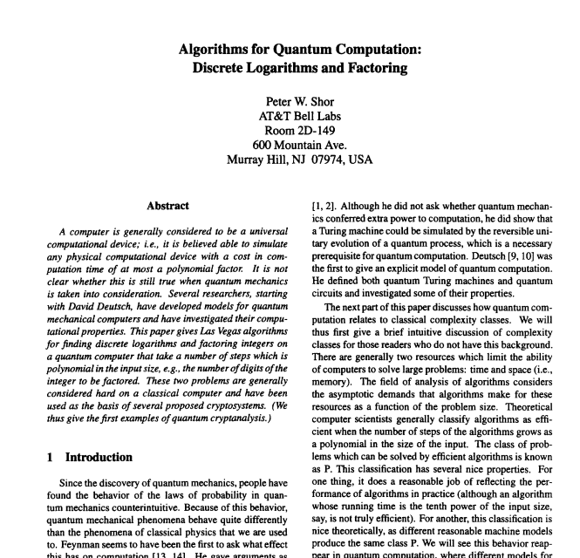
How we got here…
NIST’s public-key crypto standards
FIPS 186, The Digital Signature Standard
SP 800-56 A/B, Recommendation for Pair-Wise Key Establishment Schemes Using Discrete Logarithm/Integer Factorization Cryptography
Quantum computers and Shor’s Algorithm

Slide 4
How we got here…
2006 – 1st PQCrypto conference in Leuven, Belgium
2009 – NIST PQC survey Quantum Resistant Public Key Cryptography: A Survey [Perlner, Cooper]
2012 – NIST begins PQC project
Apr 2015 – NIST Workshop on Cybersecurity in a Post-Quantum World
Aug 2015 – NSA announcement
Feb 2016 – NIST Report on PQC (NISTIR 8105)
Feb 2016 – NIST announcement of “competition-like process” at PQCrypto in Japan
Dec 2016 – Final requirements and evaluation criteria published
Nov 2017 – Deadline for Submissions
Dec 2017 – Round 1 begins – 69 candidates accepted as “complete and proper”
Apr 2018 – 1st NIST PQC Standardization Workshop
Jan 2019 – Round 2 candidates announced
Aug 2019 – 2nd NIST PQC Standardization Workshop
Notes:
Not to say others not doing anything
10th PQCrypto this year in Chongqing, China

Slide 5
The “Competition”
Scope:
Digital Signatures
EUF-CMA up to 2⁶⁴ signature queries
Public-key Encryption / Key-Encapsulation Mechanisms (KEMs)
IND-CCA up to 2⁶⁴ decryption/decapsulation queries
IND-CPA option
Open and transparent process
Unlike previous AES and SHA-3 competitions, there will not be a single “winner”

Slide 6
Evaluation Criteria
Security – against both classical and quantum attacks
NIST asked submitters to focus on levels 1,2, and 3. (Levels 4 and 5 are for very high security)
Performance – measured on various classical platforms
Other properties: Drop-in replacements, Perfect forward secrecy, Resistance to side-channel attacks, Simplicity and flexibility, Misuse resistance, etc.
Level | Security Description
I | At least as hard to break as AES128 (exhaustive key search)
II | At least as hard to break as SHA256 (collision search)
III | At least as hard to break as AES192 (exhaustive key search)
IV | At least as hard to break as SHA384 (collision search)
V | At least as hard to break as AES256 (exhaustive key search)
Notes:
These are understood to be preliminary estimates

Slide 7
The 1st Round Candidates
82 submissions received.
69 accepted as “complete and proper” (5 withdrew)
 | Signatures | KEM/Encryption | Overall
Lattice-based | 5 | 21 | 26
Code-based | 2 | 17 | 19
Multi-variate | 7 | 2 | 9
Symmetric-based | 3 |  | 3
Other | 2 | 5 | 7
Total | 19 | 45 | 64

Slide 8
The 1st Round 2nd Round Candidates
 | Signatures |  | KEM/Encryption |  | Overall
Lattice-based | 5 | 3 | 21 | 9 | 26 | 12
Code-based | 2 | 0 | 17 | 7 | 19 | 7
Multi-variate | 7 | 4 | 2 | 0 | 9 | 4
Symmetric-based | 3 | 2 |  |  | 3 | 2
Other | 2 | 0 | 5 | 1 | 7 | 1
Total | 19 | 9 | 45 | 17 | 64 | 26

Slide 9
Overview of the 1st Round
Began Dec 2017 – 1st Round Candidates published
Resources:
Internal and external cryptanalysis
21 of the 69 schemes had been broken/attacked by April
The 1st NIST PQC Standardization Workshop
Research publications
Performance benchmarks
Official comments
The pqc-forum mailing list

Slide 10
NIST’s Process
Dec 2017 – Check submissions for completeness
Jan to Sep 2018 – Detailed internal presentations on submissions
Apr 2018 – 1st Workshop – submitter’s presentations
Sep to Nov 2018 – Review and make preliminary decisions
Compare similar type schemes to each other
Dec 2018 – Final decision and start report (NISTIR 8240)
Very hard decisions
NISTIR 8240 – Status Report on the 1st Round of the NIST PQC Standardization Process
Report focused on the reasons for moving on
Announced 2nd Round candidates – Jan 30, 2019

Slide 11
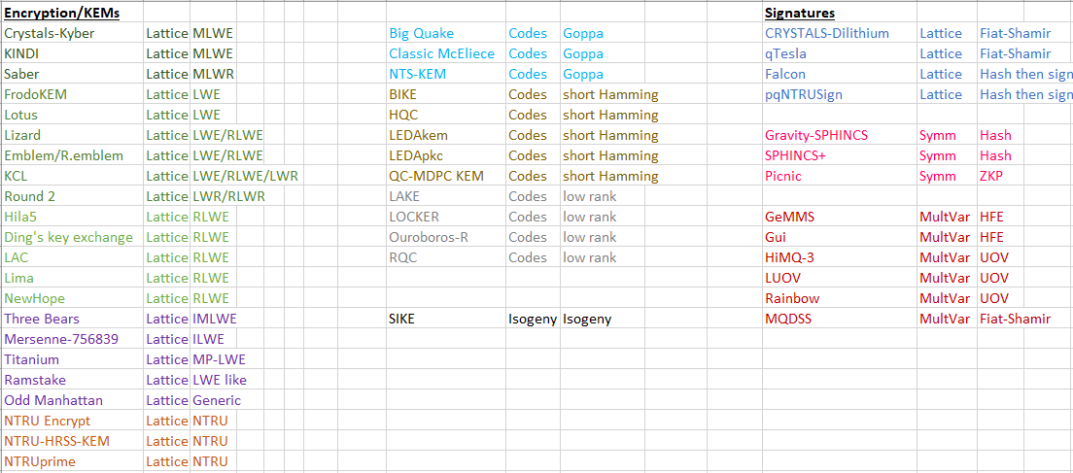
Apples and Oranges
Notes:
Doesn’t include the ones we lacked full security in, and the 3 eliminated for performance reasons

Slide 12
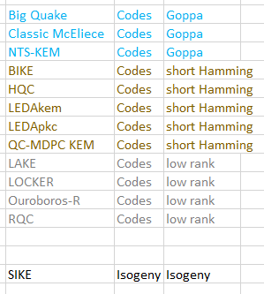
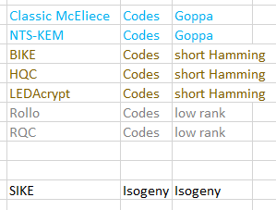
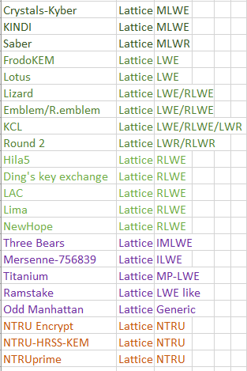
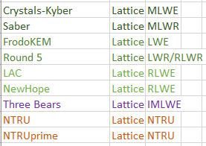
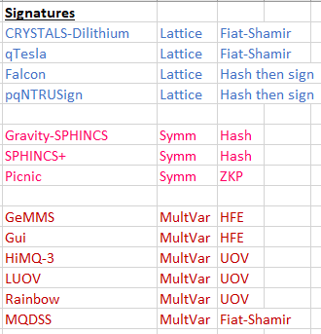
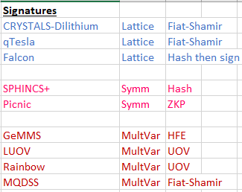
Biting the Bullet
Notes:
Result of Mergers + cuts
Hard decisions

Slide 13
The Second Round (and beyond)
NIST is still open to mergers
Only need new IP statements if new team members have joined, or if IP status has changed
Later on in process, IP concerns may play a larger role in our decisions
The 2nd Round will take 12-18 months, after which we expect to have a 3rd Round
Overall timeline: we still expect draft standards around 2022ish
(but reserve the right to change this!)
Notes:
We are proceeding in a similar fashion to the 1st round.
For 3rd round – competing factors. Not move too fast, nor too slow. We’re trying to keep all options open.

Slide 14
Performance
We have internal numbers, based on implementations sent to us
We strongly prefer code that is constant time
Performance will play a larger role in the 2nd Round
We encourage benchmarking on a variety of platforms
We are looking for mature schemes – beyond just proof of concept
Implementations can always be updated
We won’t change the implementations on our Round 2 webpage
Teams should feel free to advertise results on the pqc-forum, and on their own websites

Slide 15
Notes:
Note logarithmic scale
Disclaimer – These are from the optimized implementations submitted to us. We know better implementations exist/will exist.

Slide 20
Notes:
Didn’t include all the Sphincs implementations

Slide 21
Stateful Hash-based signatures
NIST plans to approve stateful hash-based signatures
1) XMSS, specified in RFC 8391
2) LMS, specified in RFC 8554
Will include their multi-tree variants, XMSS^MT and HSS
In Feb 2019, NIST issued a request for public input on how to mitigate the potential misuse of stateful HBS schemes.
See comments received here
Will recommend HBS schemes limited to scenarios in which a digital signature scheme needs to be deployed soon, but where risks of accidental one-time key reuse can be minimized
NIST expects to have a draft Special Publication (SP) published by the end of 2019
Notes:
Most comments offering advice, caution. Adam said probably not worth it.

Slide 22
What NIST wants
Performance (hardware+software) will play more of a role
More benchmarks
For hardware, NIST asks to focus on Cortex M4 (with all options) and Artix-7
pqc-hardware-forum
How do schemes perform on constrained devices?
Side-channel analysis (concrete attacks, protection, etc…)
Continued research and analysis on ALL of the 2nd round candidates
See how submissions fit into applications/procotols. Any constraints?
Notes:
We are looking for mature schemes
-- We still would prefer MUCH more hardware analysis -- The PQC-Hardware-Forum is open, but not used yet [[This is the "primary point in time" that we could encourage kicking off more discussion there..]] 1) PERFORMANCE: How do the schemes perform on constrained hardware? Do they all "fit"? Are there large changes in performance vs. the software implementations we already have? 2) SECURITY: Side-channel analysis -- this area is still /mostly/ wide-open. We are listening intently for any work on side-channel attacks and side-channel resilience. Please give us: a) New side-channel attacks on the concrete candidates, evaluate this in practice! b) Theoretical, high-level analysis of how resistant these schemes' hardness assumptions are to side-channel attacks c) Practical "side-channel masking" -- either "masked implementations," "re-ordering of algorithms' code to prevent attacks," etc.

Slide 23
Summary
Round 2 is ongoing….
26 candidate algorithms (17 encryption/KEM, 9 signatures)
We will continue to work in an open and transparent manner with the crypto community for PQC standards
Check out: www.nist.gov/pqcrypto
Sign up for the pqc-forum
Talk to us: pqc-comments@nist.gov

